Slide 1
Online Retail Data
Group 2
Vibhu Krovvidi
Wei Xiong Toh
Yu Song Ng

Slide 2
Agenda
1
2
Problem and Business Value
Process and Change Management
3
4
Data Sources
Project Milestones and Timeline
5
6
Architecture
Model
7
8
Results
Challenges and Future Steps

Slide 3
Introduction to Dataset
Dataset shows online retail sales from Dec 2009 to Dec 2011
Price & Quantity
Price and number of items purchased, when multiplied gives Gross Merchandise Value (GMV)
Description
Description of item purchased (different categories of gifts)
InvoiceDate
Date and Time order was processed
Customer, Order and Stock ID
Identifiers for customer, order and product
Country
Location of customer

Slide 4
Problem and Business Value
Problem
GMV is a crucial metric for operational decisions, but difficult to forecast accurately
Value Creation
Potential to improve logistics and manpower management, reduce buffer stock requirements
Objective
Predict GMV with sufficient accuracy
Identify purchase patterns and trends for item types to adapt to changes in consumer preferences
Obtain insight on when and how additional marketing strategies can be used to boost GMV as required

Slide 5
Approach
Dependent Variables
Average earnings (wages) in the UK
FTSE 100 historical data
Retail sales in the UK
Monthly unemployment rate in the UK
Target Variable
Gross Merchandise Value
(Sum of all sales in a period)

Slide 6
Data Exploration Observations
Over 90% of sales came from the UK
Location
Some entries had negative quantities, corresponds to cancellations
Negative Quantity
No sales on Saturdays
Cycles
Annual peak in GMV occurs at the end of each year
Seasonality

Slide 7
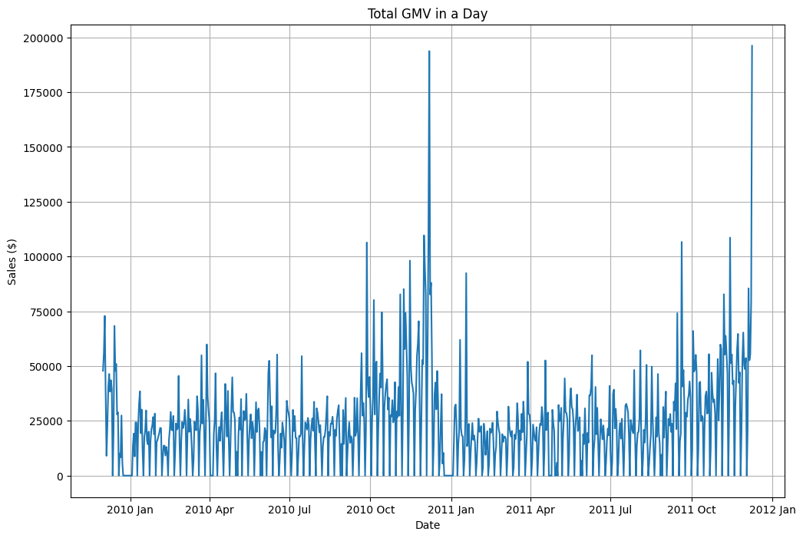
Daily GMV
b
0 values on holidays and saturdays will be removed
Extreme values during the holiday season to be replaced by 7 day moving average values
a

Slide 8
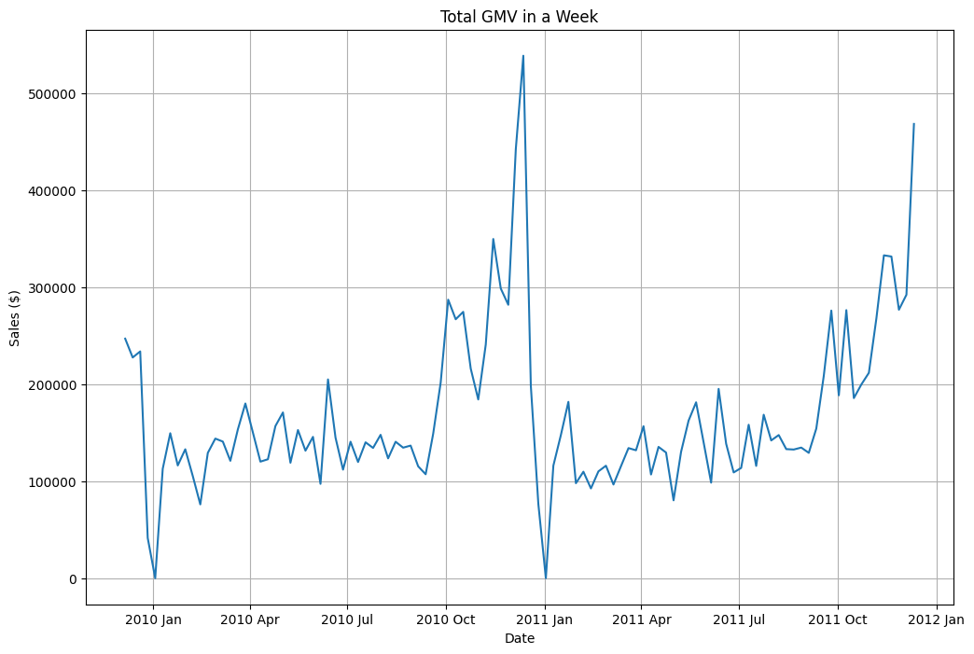
Weekly GMV

Slide 9
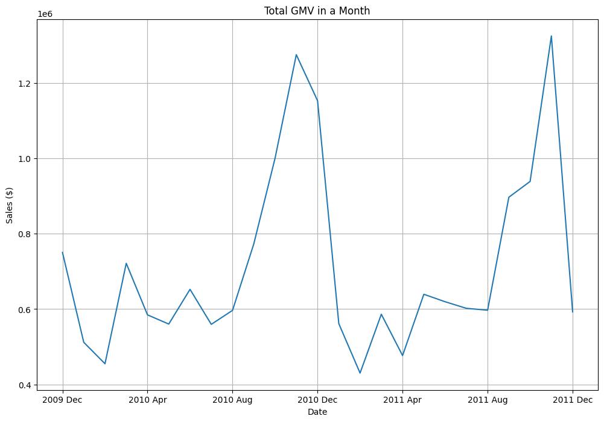
Monthly GMV

Slide 10
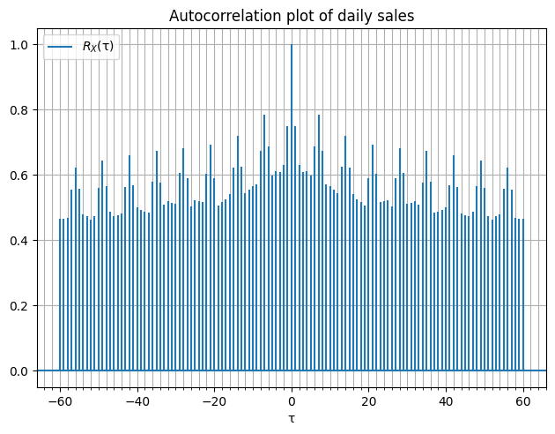
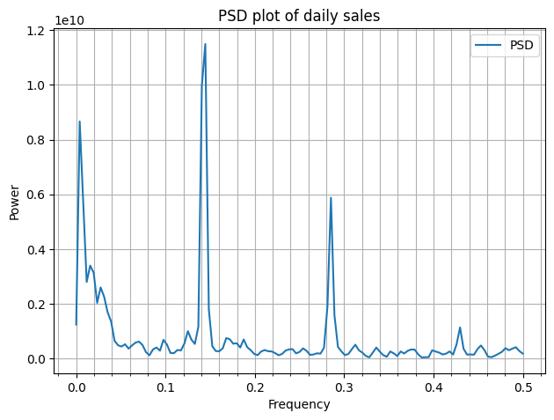
Autocorrelation Daily GMV
Strong presence of cycle every 7 days

Slide 11
Methodology
Iteration 1
Training
Validation
Test
Iteration 2
Training
Validation
Test
Iteration 3
Training
Validation
Test
Model is trained with 3-fold cross validation on 75% of the data
Remaining 25% is used to test the resulting model
Model is evaluated with error metric MAPE during validation as well as on the test data (split into 4 time periods)

Slide 12
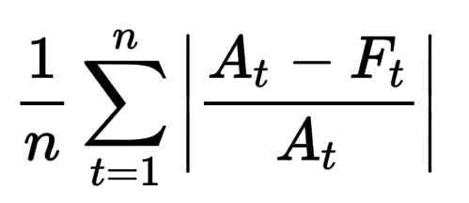
Error Metrics
Mean Absolute Percentage Error (MAPE):
Metric | Advantages | Disadvantages
MAPE | Easy to interpret and explain | Has no upper bound, penalizes over-forecasting more
Solution | Upper bound it by 100%

Slide 13
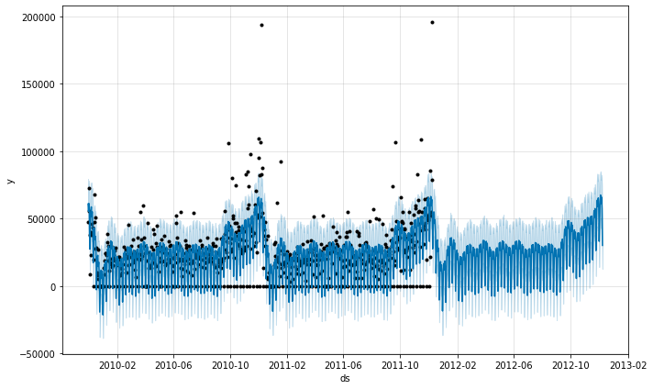
Model 1: Facebook Prophet
Training data
1 year forecast

Slide 14
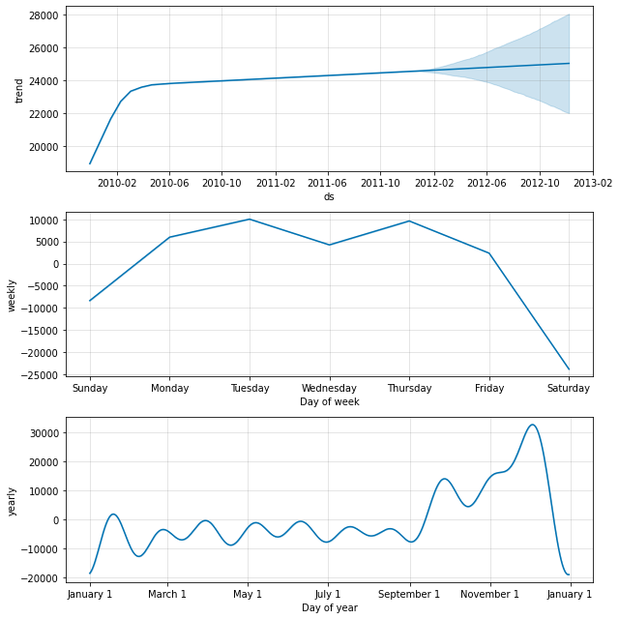
Model 1: Facebook Prophet Trends

Slide 15
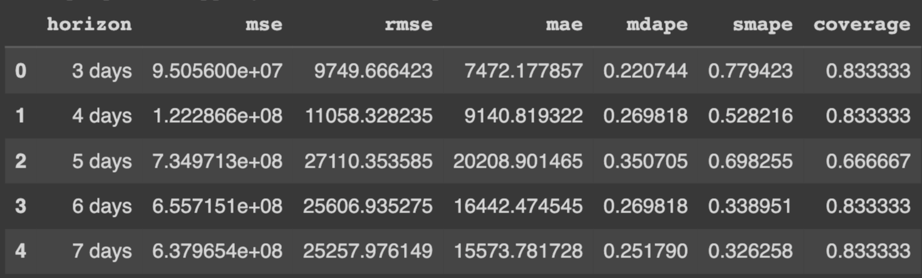
Model 1: Facebook Prophet Evaluation

Slide 16
Model 2: Auto ARIMA
Grid Search for ARIMA hyperparameters for every iteration of training
Best model was chosen based on lowest MAPE on test set
Iteration | Best Model | MAPE
1 | ARIMA(1,0,1) | 18.4%
2 | ARIMA(5,0,6) | 31.8%
3 | ARIMA(14,0,0) | 45.4%

Slide 17
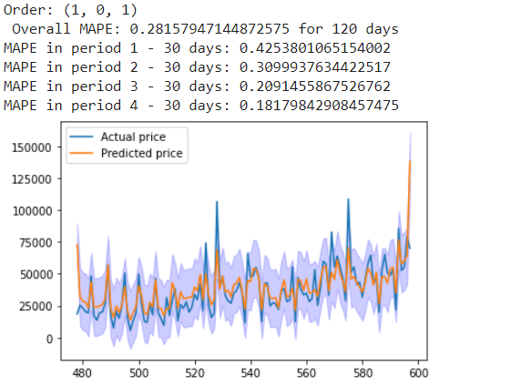
Model 2: Auto ARIMA

Slide 18
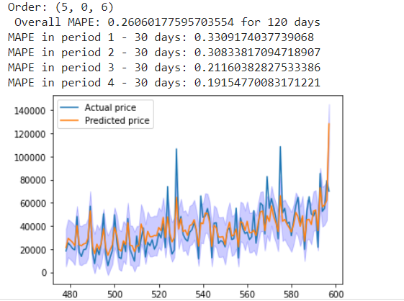
Model 2: Auto ARIMA

Slide 19
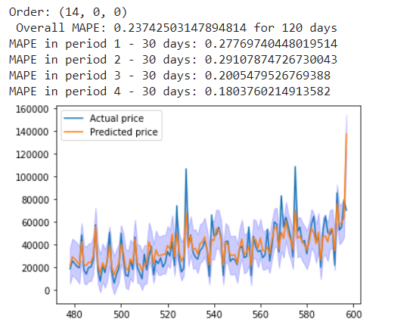
Model 2: Auto ARIMA

Slide 20
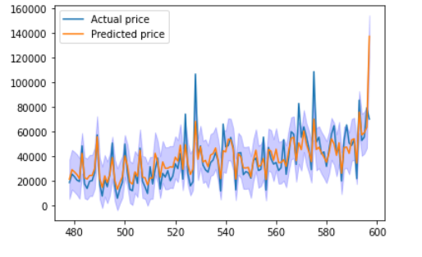
Model 2: Auto ARIMA
Time Period | MAPE
First 1/4 | 27.8%
Second 1/4 | 29.1%
Third 1/4 | 20.1%
Fourth 1/4 | 18.0%
Overall | 23.7%

Slide 21
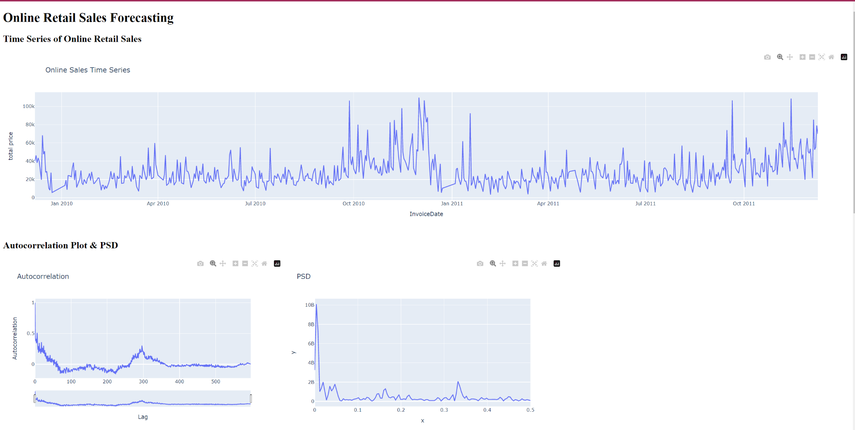
Dashboard
Allows all stakeholders to have a birds-eye view and enable smooth change management
Data visualization

Slide 22
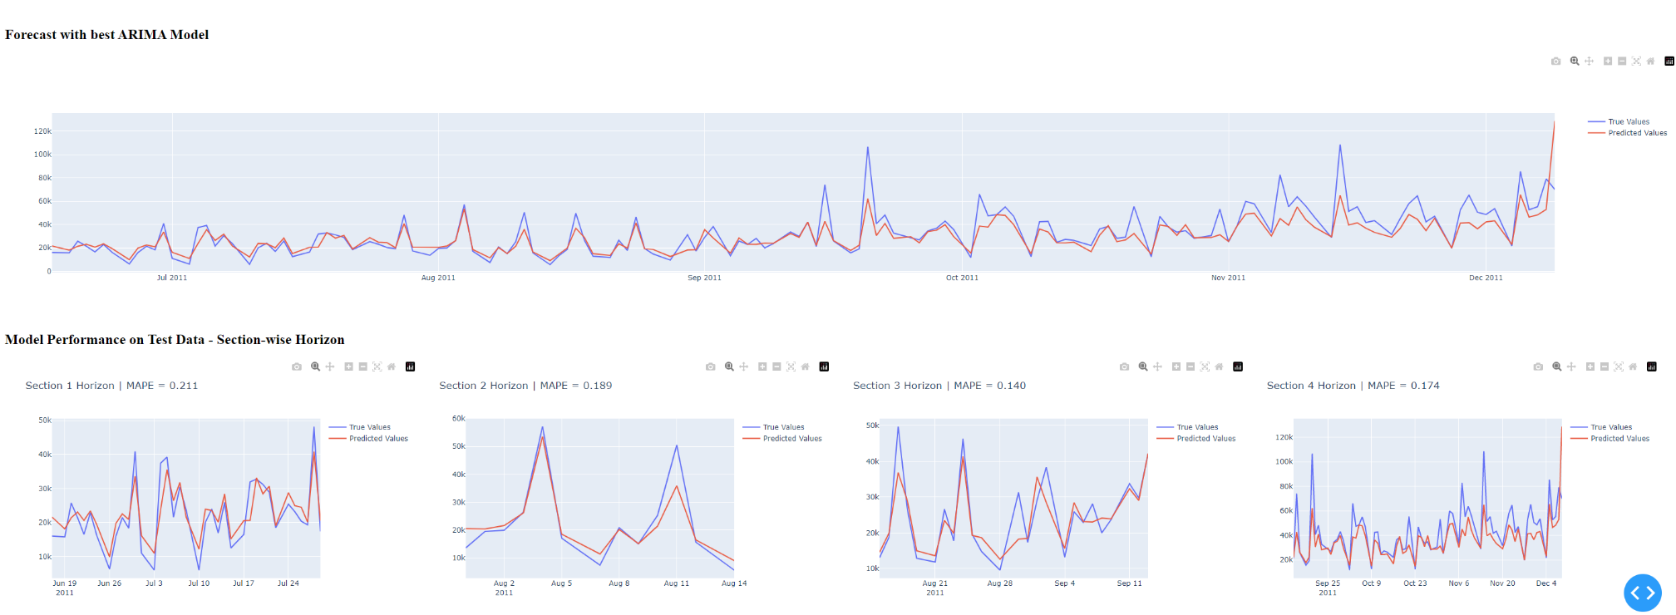
Dashboard
Allows all stakeholders to have a birds-eye view and enable smooth change management
Model Forecast

Slide 23
Modelling Limitations
Insufficient data, model cannot capture seasonal differences when training
Huge spikes in sales during holiday season have to be treated like outliers
Lack of variables in dataset provided - omitted variable bias

Slide 24
Data Exploration
Mercury
Venus
Mercury is the smallest planet in the Solar System
Venus is terribly hot, even hotter than Mercury
Saturn
Mars
Saturn is a gas giant and has several rings
Despite being red, Mars is actually a cold place
Jupiter
Earth
Jupiter is the biggest planet in the Solar System
Earth is the third planet and is where we all live on

Slide 25
Online Shopping Sales Infographics
Mars
Mercury
Saturn
Jupiter
Despite being red, Mars is actually a cold place
It’s the smallest planet in the Solar System
Saturn is a gas giant and has several rings
It’s the biggest planet in the Solar System

Slide 26
Online Shopping Sales Infographics
Mercury
Venus
Mercury is the smallest planet in the Solar System
Venus is terribly hot, even hotter than Mercury
Saturn
Mars
Saturn is a gas giant and has several rings
Despite being red, Mars is actually a cold place

Slide 27
Online Shopping Sales Infographics
Express shipping | Fast shipping | Standard shipping
+ 10$ | + 6$ | + 2$
2 days | 4 days | 7 days
2-4 lbs | 2-4 lbs | 3-5 lbs

Slide 28
Online Shopping Sales Infographics
Mercury
Venus
Mercury is the smallest planet in the Solar System
Venus is terribly hot, even hotter than Mercury
Saturn
Mars
Saturn is a gas giant and has several rings
Despite being red, Mars is actually a cold place
Jupiter
Earth
Jupiter is the biggest planet in the Solar System
Earth is the third planet and is where we all live on

Slide 29
Online Shopping Sales Infographics
Mercury
Jupiter
Earth
Mars
Mercury is the smallest planet in the Solar System
It’s the biggest planet in the Solar System
Earth is the third planet and is where we all live on
Despite being red, It is actually a cold place

Slide 30
Online Shopping Sales Infographics
Saturn
Jupiter
Neptune is the farthest planet
Jupiter is the biggest planet
Mercury
Earth
Mars
Venus
Mercury is the smallest planet
Earth is the planet where we all live on
Mars is actually a cold place
Venus is hotter than Mercury

Slide 31
Online Shopping Sales Infographics
Item 1
-10%
Mercury is the smallest planet
Item 2
-5%
Neptune is the farthest planet
Item 3
-20%
It’s the planet where we live on
Item 4
-25%
Jupiter is the biggest planet
Item 5
-35%
Mars is actually a cold place
Item 6
-20%
It’s even hotter than Mercury

Slide 32
Online Shopping Sales Infographics
1
Venus
2
Mercury
Venus is terribly hot, even hotter than Mercury
Mercury is the closest planet to the Sun
3
Earth
4
Mars
Earth is the third planet and is where we all live on
Despite being red, Mars is actually a cold place
6
Jupiter
6
Saturn
Jupiter is the biggest planet in the Solar System
It’s composed of hydrogen and helium

Slide 33
Online Shopping Sales Infographics
Mercury
Venus
Jupiter
Mercury is the smallest planet in the Solar System
Venus is terribly hot, even hotter than Mercury
Jupiter is the biggest planet in the Solar System
Earth
Saturn
Mars
Earth is the third planet and is where we all live on
Saturn is a gas giant and has several rings
Despite being red, Mars is actually a cold place

Slide 34
Online Shopping Sales Infographics
These are the shipping costs of your online purchases
Shipping | Rate
6 Days | + $4
4 Days | + $6
2 Days | + $10
1 Day | + $16

Slide 35
Online Shopping Sales Infographics
Venus
Mars
Earth
Venus is terribly hot, even hotter than Mercury
Despite being red, Mars is actually a cold place
Earth is the third planet and is where we all live on

Slide 36
Online Shopping Sales Infographics
Search product
Payment
Happy shopping
Mercury is the smallest planet in the Solar System
Earth is the third planet and is where we all live on
Despite being red, Mars is actually a cold place

Slide 37
Online Shopping Sales Infographics
1
Jupiter
Venus
2
Jupiter is the biggest planet in the Solar System
Venus is terribly hot, even hotter than Mercury
3
Mercury
Saturn
4
Mercury is the smallest planet in the Solar System
Saturn is a gas giant and has several rings
5
Mars
Earth
6
Despite being red, Mars is actually a cold place
Earth is the third planet and is where we all live on

Slide 38
Online Shopping Sales Infographics
Saturn
Earth
Mars
Saturn is a gas giant and has several rings
Earth is the third planet and is where we all live on
Despite being red, Mars is actually a cold place
Jupiter
Mercury
Venus
Jupiter is the biggest planet in the Solar System
Mercury is the smallest planet in the Solar System
Venus is terribly hot, even hotter than Mercury

Slide 39
Online Shopping Sales Infographics
Jupiter
Mars
Jupiter is a gas giant and the biggest object in the Solar System
Despite being red, Mars is actually a very cold place
Saturn
Mercury
Saturn is composed mostly of hydrogen and also of helium
Mercury is the closest planet to the Sun and the smallest one

Slide 40
Online Shopping Sales Infographics
Mercury
Venus
Mercury is the smallest planet in the Solar System
Venus is terribly hot, even hotter than Mercury
Saturn
Mars
Saturn is a gas giant and has several rings
Despite being red, Mars is actually a cold place
Jupiter
Earth
Jupiter is the biggest planet in the Solar System
Earth is the third planet and is where we all live on

Slide 41
Online Shopping Sales Infographics
Online shopping process
1 | 2 | 3 | 4 | 5 | 6
Mars | Venus | Jupiter | Neptune | Saturn | Mercury
Despite being red, Mars is a cold place | Venus is the second planet from the Sun | Jupiter is the biggest planet in the Solar System | Neptune is the farthest planet from the Sun | Saturn is a gas giant and has several rings | It is the smallest planet in the Solar System

Slide 42
Online Shopping Sales Infographics
Venus has a beautiful name and is the second planet from the Sun
Venus
Mercury is the closest planet to the Sun and the smallest one
Mercury
Jupiter is a gas giant and the biggest planet in the Solar System
Jupiter
Despite being red, Mars is actually a cold place full of iron oxide dust
Mars

Slide 43

Online Shopping Sales Infographics
Most purchased products online
35%
25%
Devices
Clothes
Mercury is the closest planet to the Sun and the smallest one
It has a beautiful name and is the second planet from the Sun
15%
25%
Toys
Media File
Jupiter is a gas giant and the biggest planet in the Solar System
Despite being red, Mars is actually a cold place full of iron oxide dust
Follow the link in the graph to modify its data and then paste the new one here. For more info, click here

Slide 44
Online Shopping Sales Infographics
Mercury
Mercury is the smallest planet in the Solar System
Mars
Saturn
Despite being red, Mars is actually a cold place
Saturn is a gas giant and has several rings
Earth
Jupiter
Earth is the third planet and is where we all live on
Jupiter is the biggest planet in the Solar System

Slide 45
Online Shopping Sales Infographics
Devices
Travels
Earth is the only planet that harbors life in the Solar System
1
2
Despite being red, Mars is actually a cold place full of iron oxide dust
Office supplies
Presents
Mercury is the closest planet to the Sun and the smallest one
3
4
Venus has a beautiful name and is the second planet from the Sun
Sports
Food
Jupiter is a gas giant and the biggest planet in the Solar System
5
6
Saturn was named after the Roman god of wealth and agriculture

Slide 46
Online Shopping Sales Infographics
Venus
Venus is terribly hot, even hotter than Mercury
Mars
Despite being red, Mars is actually a cold place
Jupiter
Jupiter is the biggest planet in the Solar System
Earth
Earth is the third planet and is where we all live on
Mercury
Mercury is the smallest planet in the Solar System

Slide 47
Online Shopping Sales Infographics
1
2
3
4
Jupiter
Mars
Earth
Venus
Jupiter is a gas giant and the biggest planet in the Solar System
Despite being red, Mars is actually a cold place full of iron oxide dust
Earth is the only planet that harbors life in the Solar System
It has a beautiful name and is the second planet from the Sun

Slide 48
Online Shopping Sales Infographics
Mercury
Venus
Mercury is the smallest planet in the Solar System
Venus is terribly hot, even hotter than Mercury
Saturn
Mars
Saturn is a gas giant and has several rings
Despite being red, Mars is actually a cold place
Jupiter
Earth
Jupiter is the biggest planet in the Solar System
Earth is the third planet and is where we all live on

Slide 49
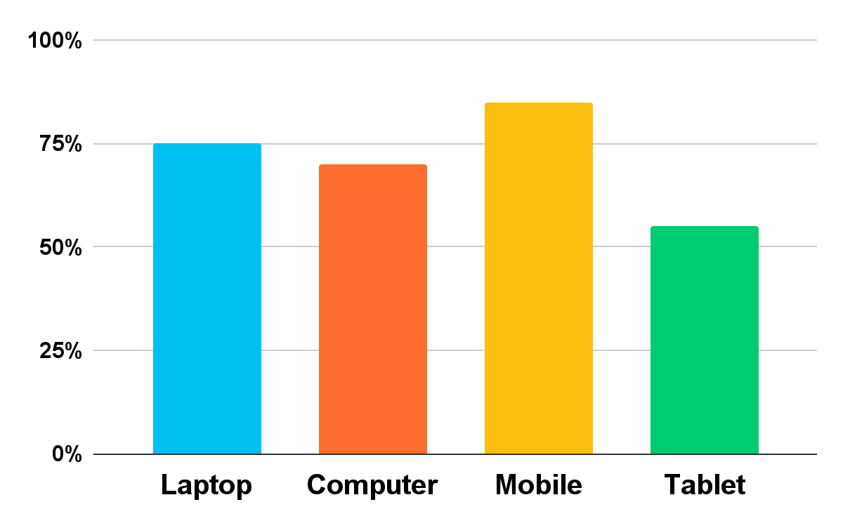
Online Shopping Sales Infographics
Most used devices to buy online
75%
70%
85%
55%
Laptop
Computer
Mercury is the smallest planet in the Solar System
Saturn is a gas giant and has several rings
Mobile
Tablet
Earth is the third planet and is where we all live on
Jupiter is the biggest planet in the Solar System
Follow the link in the graph to modify its data and then paste the new one here. For more info, click here

Slide 50
Online Shopping Sales Infographics
Venus
Venus has a beautiful name and is the second planet from the Sun
Mercury
Mercury is the closest planet to the Sun and the smallest one
Mars
Despite being red, It is actually a cold place full of iron oxide dust
Jupiter
It is a gas giant and the biggest planet in the Solar System

Slide 51
Instructions for use
In order to use this template, you must credit Slidesgo in your final presentation.
You are allowed to:
- Modify this template.
- Use it for both personal and commercial projects.
You are not allowed to:
- Sublicense, sell or rent any of Slidesgo Content (or a modified version of Slidesgo Content).
- Distribute Slidesgo Content unless it has been expressly authorized by Slidesgo.
- Include Slidesgo Content in an online or offline database or file.
- Offer Slidesgo templates (or modified versions of Slidesgo templates) for download.
- Acquire the copyright of Slidesgo Content.
For more information about editing slides, please read our FAQs or visit Slidesgo School:
https://slidesgo.com/faqs and https://slidesgo.com/slidesgo-school

Slide 52
Instructions for use (premium users)
As a Premium user, you can use this template without attributing Slidesgo.
You are allowed to:
Modify this template.
Use it for both personal and commercial purposes.
Hide or delete the “Thanks” slide and the mention to Slidesgo in the credits.
Share this template in an editable format with people who are not part of your team.
You are not allowed to:
Sublicense, sell or rent this Slidesgo Template (or a modified version of this Slidesgo Template).
Distribute this Slidesgo Template (or a modified version of this Slidesgo Template) or include it in a database or in any other product or service that offers downloadable images, icons or presentations that may be subject to distribution or resale.
Use any of the elements that are part of this Slidesgo Template in an isolated and separated way from this Template.
Register any of the elements that are part of this template as a trademark or logo, or register it as a work in an intellectual property registry or similar.
For more information about editing slides, please read our FAQs or visit Slidesgo School:
https://slidesgo.com/faqs and https://slidesgo.com/slidesgo-school

Slide 53
Infographics
You can add and edit some infographics to your presentation to present your data in a visual way.
Choose your favourite infographic and insert it in your presentation using Ctrl C + Ctrl V or Cmd C + Cmd V in Mac.
Select one of the parts and ungroup it by right-clicking and choosing “Ungroup”.
Change the color by clicking on the paint bucket.
Then resize the element by clicking and dragging one of the square-shaped points of its bounding box (the cursor should look like a double-headed arrow). Remember to hold Shift while dragging to keep the proportions.
Group the elements again by selecting them, right-clicking and choosing “Group”.
Repeat the steps above with the other parts and when you’re done editing, copy the end result and paste it into your presentation.
Remember to choose the “Keep source formatting” option so that it keeps the design. For more info, please visit Slidesgo School.

